Slide 1
FAIR USE NOTICE
The material used in this presentation i.e., pictures/graphs/text, etc. is solely intended for educational/teaching purpose, offered free of cost to the students for use under special circumstances of Online Education due to COVID-19 Lockdown situation and may include copyrighted material - the use of which may not have been specifically authorised by Copyright Owners. Its application constitutes Fair Use of any such copyrighted material as provided in globally accepted law of many countries. The contents of presentations are intended only for the attendees of the class being conducted by the presenter.

Slide 2
CLOUD COMPUTING
Notes:
2

Slide 3
Content
Distributed Computing
Types of Distributed Computing
Cluster Computing
Grid Computing
Parallel Processing
Flynn’s Taxonomy
Thread models

Slide 4
COMPUTING
Originally, the word computing was synonymous with counting and calculating, and a science that deals with the original sense of computing mathematical calculations but now it has come to mean the operation and usage of computing machines, the electrical processes carried out within the computing hardware itself, and the theoretical concepts governing them.”
“Calculation or manipulation of data with the computer machines done with different types of computers as microcomputers ( a PC or Lap top etc), mainframe or super computer, nowadays even the mobile devices.”
May be business computing , scientific computing etc.

Slide 5
Computer Performance
Super computers can now compute in the range of petaFLOPS.
By the end of the decade, it may go to exaFLOPS
FLOPS: Short for floating-point operations per second, a common benchmark measurement for rating the speed of microprocessors.

Slide 6
What is DISTRIBUTED COMPUTING?
The word distributed means “divided or dispersed”, geographically or physically.
“The coordinated use of physically distributed computers, is called as the distributed computing”.
Distributed computing is a model in which components of a software system are shared among multiple computers to improve efficiency and performance.

Slide 7
DISTRIBUTED COMPUTING
Distributed computing has become a common term in today’s programming vocabulary. It refers to:
“Application design paradigm in which the programs, the data they process and the actual computations are spread over a network”. This may be done because of one of the two reasons:
To leverage the processing capability of multiple computers
Due to inherent nature of the application. For example, an application comprised of smaller applications spread over the network.

Slide 8
NEED OF DISTRIBUTED COMPUTING
Mainly to cope with the extremely higher demand of users in both processing power and data storage.
Moore's law, we all know, says that the performance of a processor doubles every 18 months .
The trend in network traffic, however, is that it doubles every 12 months (or less). So the increase in network traffic is outpacing the increase in processor performance.
Simple, the processors can’t keep up.
Example: Google servers.
Notes:
The trends to look at are those described by Moore's law having to do with processors and the trends in network traffic (not speed). Moore's law, we all know, says that the performance of a processor doubles every 18 months (or that the price is cut in half for the same performance). The trend in network traffic, however, is that it doubles every 12 months (or less). So the increase in network traffic is outpacing the increase in processor performance, at the same time that competent processors are becoming cheaper (and therefore being placed out on the edges of the network cloud). It's just math, folks--the processors can't keep up.
8

Slide 9
Performance Needed for Big Problems
Example: Global Climate Modeling
Divide the world into a grid (e.g. 20 km spacing)
Solve fluid dynamic equations for each point and minute.
Requires about 100 flops per grid point per minute
Weather prediction (7 days in 24 hours)
56GFlops
Climate prediction( 50 years in 30 days)
4.8 Tflops
Perspective
Intel Core i7 Desktop processor
~100GFlops
Climate prediction would take ~5years.

Slide 10
What can we do? Use multiple CPUs
Supercomputing
Multiple processors “all in one box/room” from one vendor that often communicate through shared memory.
Distributed computing
Many separate computers (each with independent CPU, RAM) that communicate through a network
Grids (heterogeneous computers across internet)
Clusters (mostly homogeneous computers all in one room)
It’s all about being able to solve “big” problems, not small problems faster
These problems can be data (mostly) or CPU intensive

Slide 11
Distributed Computing Challenges
Communication is fundamental difficulty
Distributing data, updating shared resource, communicating results, handling failures
Machines have separate memory so need network
Introduces inefficiencies: overhead, waiting, etc
Need to parallelize algorithms
Must look at problems from parallel standpoint (“embarrassingly parallel” )
Best for problems whose compute times >> overhead
Example: Rendering picture (Render farm using internal clusters)
Notes:
http://education-portal.com/academy/lesson/what-is-distributed-computing-principles-environments-applications.html#lesson
Mapreduce logarithmic class example
11

Slide 12
DISTRIBUTED COMPUTING SYSTEM
A system of computers or devices in which we can do the distributed computing.
A distributed system is a collection of independent computers that appears to its users as a single coherent system
This system needs a complete infrastructure such as a network established in a LAN or WAN environment with interconnected server and the workstations.
This sort of the structure helps to process the application on different places or machines.

Slide 13
A distributed system is a software system in which components located on networked computers communicate and coordinate their actions by passing messages.
An example of a distributed system is the World Wide Web.
As you are reading a web page, you are actually using the distributed system that comprises the site.
As you are browsing the web, your web browser running on your own computer communicates with different web servers that provide web pages. Possibly, your browser uses a proxy server to access the web contents stored on web servers faster and more securely. To find these servers, it also uses the distributed domain name system. Your web browser communicates with all of these servers over the Internet, via a system of routers which are themselves part of a large distributed system.

Slide 14
EXAMPLES OF DISTRIBUTED SYSTEMS
Social Networking (Facebook)
Distributed File Systems (Hadoop)
Cloud Network
Grid Computing (SETI@home)
Google bots, Google Indexer etc.
Notes:
Googlebot was designed to be distributed on several machines to improve performance and scale as the web grows. Also, to cut down on bandwidth usage, we run many crawlers on machines located near the sites they're indexing in the network.
14

Slide 15
GOALS OF DISTRIBUTED COMPUTING
The main goal of a distributed computing system is to connect users and resources in
A transparent,
open,
and scalable way.

Slide 16
OPENNESS
Openness is the property of distributed systems such that each subsystem is continually open to interaction with other systems.
A system is said to be open if it can add, replace and integrate new components without disrupting the users.
In general, an open system that scales has an advantage over a perfectly closed and self-contained system.

Slide 17
Open System
Open system is able to interact with services from other open systems, irrespective of the underlying environment:
Systems should conform to well-defined interfaces
Systems should support portability of applications
Systems should easily interoperate

Slide 18
SCALABILITY
A scalable system is one that can easily be altered to accommodate changes in the number of users, resources and computing entities affected by it. Scalability can be measured in three different dimensions:
Load scalability — A distributed system should make it easy for us to expand and contract its resource pool to accommodate heavier or lighter loads.
Geographic scalability — A geographically scalable system is one that maintains its usefulness and usability, regardless of how far apart its users or resources are. It deals with maximum distance between nodes
Administrative scalability — No matter how many different organizations need to share a single distributed system, it should still be easy to use and manage.

Slide 19
TRANSPARENCY
The distributed systems should be perceived as a single entity by the users or the application programmers rather than as a collection of autonomous systems, which are cooperating.
The implementation of the distributed system is very complex, as a number of issues have to be considered to achieve its final objective. The complexities should not worry the user of the distributed system from using it i.e., the complexities should be hidden from the user who uses the distributed system.

Slide 20
TRANSPARENCY TYPES
Access transparency – Regardless of how resource access and representation has to be performed on each individual computing entity, the users of a distributed system should always access resources in a single, uniform way. The example illustrating this property is the Navigation of the web.
Location transparency – Users of a distributed system should not have to be aware of where a resource is physically located.
Notes:
Location: Clients should see a uniform file name space. Files or groups of files may be relocated without changing their pathnames.
20

Slide 21
TRANSPARENCY TYPES
Concurrency transparency – While multiple users may compete for and share a single resource, this should not be apparent to any of them. Users and Applications should be able to access shared data or objects without interference between each other. Example ATM network.
Failure transparency – Always try to hide any failure and recovery of computing entities and resources. Any failure must not degrade quality of services and the processing being done.
Persistence transparency – Whether a resource lies in volatile or permanent memory should make no difference to the user.

Slide 22
TRANSPARENCY TYPES
Migration transparency – Users should not be aware of whether a resource or computing entity (information or process) possesses the ability to move to a different physical or logical location.
Replication transparency – If a resource is replicated among several locations (distributed file systems), it should appear to the user as a single resource. Reading and updating of replicated data will appear to the user/programmer as if it is performed on one single local copy. Example: DDBMS.
Performance transparency - Allows the system to be reconfigured to improve the performance as the load varies.

Slide 23
DISTRIBUTED DATA AND DATABASE
A distributed database is a database that is under the control of a central database management system (DBMS) in which storage devices are not all attached to a common CPU. It may be stored in multiple computers located in the same physical location, or may be dispersed over a network of interconnected computers.
Collections of data (e.g. in a database) can be distributed across multiple physical locations. A distributed database can reside on network servers on the Internet, on corporate intranets or extranets, or on other company networks.

Slide 24
EXAMPLE APPLICATIONS
Distributed computing is widely used for complex scientific calculations. However, it is also used for applications where the overall goal is not necessarily doing calculations but collecting data at different locations.
For example, a wireless sensor network uses computing devices at multiple locations to collect data that are processed centrally. This is widely used for things like environmental monitoring and weather forecasting.
Notes:
24

Slide 25
CLASSIFICATION OF DISTRIBUTED COMPUTING
Types of Distributed Computing Systems
Multiprocessor Systems
Multi computer Systems
Distributed Computing Models
Grid Computing
Cluster Computing
Parallel Computing/Processing

Slide 26
TYPES OF DISTRIBUTED COMPUTING SYSTEMS
Multiprocessor Systems
A multiprocessor system is simply a computer that has more than one CPU on its motherboard. If the operating system is built to take advantage of this, it can run different processes on different CPUs, or different threads belonging to same process.
Over the years, many different multiprocessing options have been explored for use in distributed computing. When they originally were released, it was just two cores in a single CPU but now there are options for four, six and even eight. In addition to that Intel CPUs employ a technology called Hyperthreading that allows more than one thread (usually two) to run on the same CPU.
Example: INTEL’s core processors (i3,i5,i7, etc)

Slide 27
TYPES OF DISTRIBUTED COMPUTING SYSTEMS
Multicomputer systems
A multicomputer system is a system made up of several independent computers interconnected by a telecommunications network. Multicomputer systems can be homogeneous or heterogeneous.
A homogeneous distributed system is one where all CPUs are similar and are connected by a single type of network. They are often used for parallel computing which is a kind of distributed computing where every computer is working on different parts of a single problem.
In contrast a heterogeneous distributed system is one that can be made up of all sorts of different computers, eventually with vastly differing memory sizes, processing power and even basic underlying architecture. They are in widespread use today, with many companies adopting this architecture due to the speed with which hardware goes obsolete and the cost of upgrading a whole system simultaneously

Slide 28
CLASSIFICATION OF DISTRIBUTED COMPUTING
Types of Distributed Computing Systems
Multiprocessor Systems
Multi computer Systems
Distributed Computing Models
Grid Computing
Cluster Computing
Parallel Computing/Processing

Slide 29
CLUSTER COMPUTING
In computers, clustering is the use of multiple computers, typically PCs or UNIX workstations, multiple storage devices, and redundant interconnections, to form what appears to users as a single highly available system. (Homogenous computers all in one room)
Cluster computing can be used for load balancing as well as for high availability
One of the main ideas of cluster computing is that, to the outside world, the cluster appears to be a single system.
Clusters are usually deployed to improve speed and/or reliability over that provided by a single computer, while typically being much more cost-effective than single computers of comparable speed or reliability.

Slide 30
A common use of cluster computing is to load balance traffic on high-traffic Web sites. A Web page request is sent to a "manager" server, which then determines which of several identical or very similar Web servers to forward the request to for handling. Having a Web farm (as such a configuration is sometimes called) allows traffic to be handled more quickly.
IBM's Sysplex is a cluster approach for a mainframe system. Microsoft, Sun Microsystems, and other leading hardware and software companies offer clustering packages that are said to offer scalability as well as availability. As traffic or availability assurance increases, all or some parts of the cluster can be increased in size or number.
Cluster computing can also be used as a relatively low-cost form of parallel processing for scientific and other applications that lend themselves to parallel operations. An early and well-known example was the Beowulf project in which a number of off-the-shelf PCs were used to form a cluster for scientific applications.

Slide 31
GRID COMPUTING
Grid computing is a form of distributed computing in which an organization (business, university, etc.) uses its existing computers (desktop and/or cluster nodes) to handle its own long-running computational tasks.
Grid computing (or the use of a computational grid) is applying the resources of many computers in a network to a single problem at the same time - usually to a scientific or technical problem that requires a great number of computer processing cycles or access to large amounts of data.
Grid computing has the design goal of solving problems too big for any single supercomputer, whilst retaining the flexibility to work on multiple smaller problems. Thus grid computing provides a multi-user environment. Its secondary aims are: better exploitation of the available computing power, and catering for the intermittent demands of large computational exercises.
A well-known example of grid computing in the public domain is the ongoing SETI (Search for Extraterrestrial Intelligence) @Home project in which thousands of people are sharing the unused processor cycles of their PCs in the vast search for signs of "rational" signals from outer space.

Slide 32
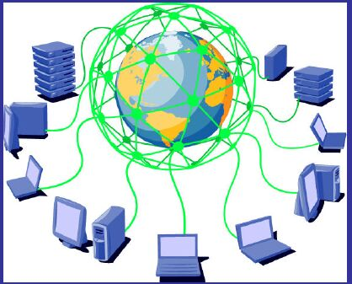
GRID COMPUTING
Grid computing requires the use of software that can divide and farm out pieces of a program to as many as several thousand computers. Grid computing can be thought of as distributed and large-scale cluster computing and as a form of network-distributed parallel processing. It can be confined to the network of computer workstations within a corporation or it can be a public collaboration (in which case it is also sometimes known as a form of peer-to-peer computing).

Slide 33
Grid computing appears to be a promising trend for three reasons:
(1) its ability to make more cost-effective use of a given amount of computer resources,
(2) as a way to solve problems that can't be approached without an enormous amount of computing power, and
(3) because it suggests that the resources of many computers can be cooperatively and perhaps synergistically harnessed and managed as a collaboration toward a common objective.
In some grid computing systems, the computers may collaborate rather than being directed by one managing computer.

Slide 34
Grid computing is also attractive to large commercial enterprises with complex computation problems who aim to fully exploit their internal computing power: internal grids.

Slide 35
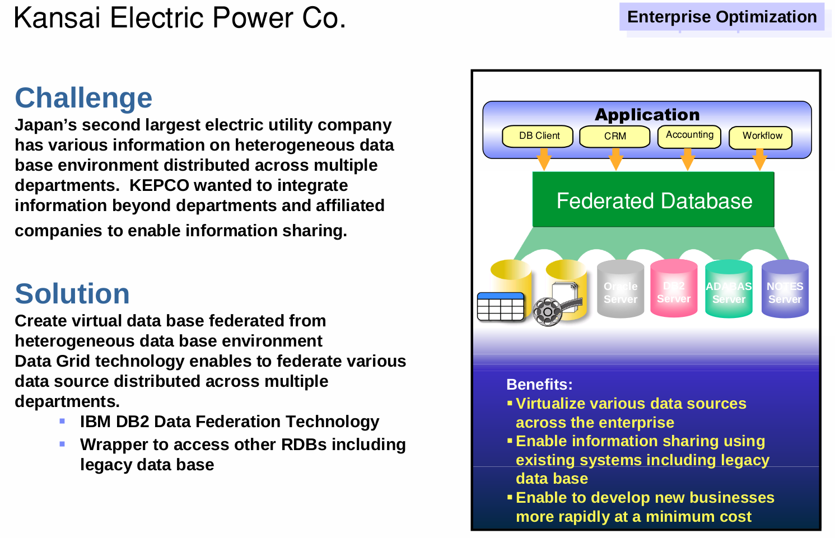

Slide 36
DIFFERENCES
Cluster computing | Grid computing
Homogenous | Heterogeneous
Computers are contained in a single location or complex (Connected over LAN) | Distributed by its nature over a LAN, metropolitan or WAN.
Tightly coupled systems | Loosely coupled (Decentralization)
Single system image | Diversity and Dynamism
Centralized Job management & scheduling system | Distributed Job Management & scheduling

Slide 37
PARALLEL PROCESSING
The simultaneous use of more than one CPU or processor core to execute a program or multiple computational threads. Ideally, parallel processing makes programs run faster because there are more engines (CPUs or cores) running it.
In practice, it is often difficult to divide a program in such a way that separate CPUs or cores can execute different portions without interfering with each other. Most computers have just one CPU, but some models have several, and multi-core processor chips are becoming the norm. There are even computers with thousands of CPUs.

Slide 38
With single-CPU, single-core computers, it is possible to perform parallel processing by connecting the computers in a network. However, this type of parallel processing requires very sophisticated software called distributed processing software.
Parallel processing is also called parallel computing. In the quest of cheaper computing alternatives parallel processing provides a viable option. The idle time of processor cycles across network can be used effectively by sophisticated distributed computing software.
Notes:
Concurrency and parallelism
37

Slide 39
PARALLEL PROCESSING: DIVIDE AND CONQUER
“Work”
Partition
w₁
w₂
w₃
“worker”
“worker”
“worker”
r₁
r₂
r₃
Combine
“Result”

Slide 40
Different workers
Different threads in the same core
Different cores in the same CPU
Different CPUs in a multi-processor system
Different machines in a distributed system

Slide 41
Parallel Programming has needs
Multiple “processes” active simultaneously solving a given problem, general multiple processors.
Communication and synchronization of its processes (forms the core of parallel programming efforts).

Slide 42
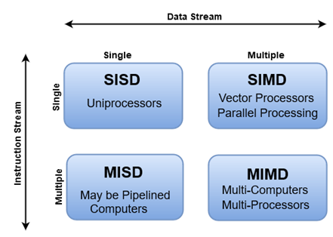
Processing Elements Architecture (Flynn’s Taxonomy)
First proposed by Michael J. Flynn in 1966, Flynn's taxonomy is a specific classification of parallel computer architectures that are based on the number of concurrent instruction (single or multiple) and data streams (single or multiple) available in the architecture. The four categories in Flynn's taxonomy are the following:

Slide 43
SISD (Single Instruction Single Data)
A single processor executes a single instruction stream, to operate on data stored in a single memory.
Speed is limited by the rate at which computer can transfer information internally.
Ex: IBM PC, Workstations, traditional von Neumann single CPU computer
Instructions
Processor
Data Input
Data Output

Slide 44
SIMD Architecture
Instruction
Stream
A single computer instruction perform the same identical action (retrieve, calculate, or store) simultaneously on two or more pieces of data. Typically this consists of many simple processors, each with a local memory in which it keeps the data which it will work on. Each processor simultaneously performs the same instruction on its local data progressing through the instructions, with the instructions issued by the controller processor.
Ex: CRAY machine vector processing.
Data Output
stream A
Data Input
stream A
Processor
A
Data Output
stream B
Data Input
stream B
Processor
B
Processor
C
Data Output
stream C
Data Input
stream C
Notes:
Cray: supercomputer manufacturer
43

Slide 45
MISD Architecture
Instruction
Stream A
Multiple Instructions Single Data
More of an intellectual exercise than a practical configuration. Few built, but commercially not available
Each processor operates under the control of an instruction stream issued by its control unit: therefore the processors are potentially all executing different programs on single data while solving different sub-problems of a single problem.
Instruction
Stream B
Instruction Stream C
Processor
A
Data
Output
Stream
Data
Input
Stream
Processor
B
Processor
C

Slide 46
MIMD Architecture
Instruction
Stream A
Instruction
Stream B
Instruction
Stream C
Unlike SISD, MISD, MIMD computer works asynchronously.
Each processor uses it own data and executes its own program (or part of the program)
Most flexible approach
Easier/cheaper to build by putting together “off-the-shelf ” processors
Data Output
stream A
Data Input
stream A
Processor
A
Data Output
stream B
Data Input
stream B
Processor
B
Processor
C
Data Output
stream C
Data Input
stream C

Slide 47
MIMD Architecture (cont’d)
Multiple computer instructions, which may or may not be the same, and which may or may not be synchronized with each other, perform actions simultaneously on two or more pieces of data. The class of distributed memory MIMD machines is the fastest growing segment of the family of high-performance computers
Shared memory (tightly coupled) MIMD
Distributed memory (loosely coupled) MIMD

Slide 48
Shared Memory MIMD machine
UMA (Uniform Memory Access)
Source PE writes data to GM & destination retrieves it
Easy to build
Limitation : reliability & expandability. A memory component or any processor failure affects the whole system.
Increase of processors leads to memory contention.
Ex. : Silicon graphics supercomputers....
Processor
A
Processor
B
Processor
C
MEMORY
MEMORY
MEMORY
BUS
BUS
BUS
Global Memory System
Notes:
IBM Power, Intel Core
47

Slide 49
Distributed Memory MIMD
IPC
channel
The class of DM-MIMD machines is undoubtedly the fastest growing part in the family of high-performance computers.
Physically distributed memory, non-uniform memory access (NUMA)
Unlike Shared MIMD
easily/ readily expandable
Highly reliable (any CPU failure does not affect the whole system)
Accessing local memory is much faster than remote memory
If most accesses are to local memory than overall memory bandwidth increases
linearly with the number of processors
Processor
A
Processor
B
Processor
C
MEMORY
MEMORY
MEMORY
BUS
BUS
BUS
Memory
System A
Memory
System B
Memory
System C

Slide 50

Serial vs Parallel
Serial Machine: function1 ( ): function2 ( ): Single CPU Time : add (t₁, t₂)
Parallel machine: function1( ) || function2 ( ) massively parallel system containing thousands of CPUs Time : max (t₁, t₂)
COUNTER
COUNTER 2
COUNTER 1
Q
Please

Slide 51
Parallel Programming Paradigms
Multithreading
Task level parallelism

Slide 52
Single and Multithreaded Processes
Single-threaded Process
Multi-threaded Process
Threads of
Execution
Single instruction stream
Multiple instruction stream
Common
Address Space
Notes:
The set of all legal addresses in memory for a given application. The address space represents the amount of memory available to a program. Interestingly, the address space can be larger thanphysical memory through a technique called virtual memory.
51

Slide 53
Basic Process Model
STACK
STACK
Shared memory segments, pipes, open files or mapped files
DATA
DATA
TEXT
TEXT
Shared Memory
maintained by kernel
processes
processes

Slide 54
Threads
Thread is a piece of code that can execute in concurrence with other threads.
It is a schedule entity on a processor
Hardware
Context
Registers
Status Word
Program Counter
Running
Thread Object

Slide 55
Threaded Process Model
Threads within a process
Independent executables
All threads are parts of a process hence communication is easier and simpler.
THREAD STACK
SHARED MEMORY
THREAD DATA
THREAD TEXT

Slide 56
Levels of Parallelism in Applications
Code-Granularity
Code Item
Large grain
(task level)
Program
Medium grain
(control level)
Function (thread)
Fine grain
(data level)
Very fine grain
(Instruction level)
With hardware
Task i-l
Task i
Task i+1
func1 ( )
{
....
....
}
func2 ( )
{
....
....
}
func3 ( )
{
....
....
}
Task
Control
Data
Instruction
a ( 0 ) =..
b ( 0 ) =..
a ( 1 )=..
b ( 1 )=..
a ( 2 )=..
b ( 2 )=..
+
x
Load

Slide 57
Task or Thread level parallelism: Task parallelism (also known as function parallelism and control parallelism) is a form of parallelization of computer code across multiple processors in parallel computing environments. Task parallelism focuses on distributing execution processes (threads) across different parallel computing nodes. Multiple threads or instruction sequences from the same application can be executed concurrently
Data level parallelism: DLP to the act of performing the same operation on multiple datum simultaneously. A classic example of DLP is performing an operation on an image in which processing each pixel is independent from the ones around it (such as brightening).

Slide 58
Instruction level parallelism: Instruction level parallelism (ILP) takes advantage of sequences of instructions that are independent of each other.
For Example:
Consider the following program:
1. e = a + b
2. f = c + d
3. g = e * f
Operation 3 depends on the results of "e" and "f" which are calculated from operations 1 and 2, so "g" cannot be calculated until both of "e" and "f" are computed.
However, operations 1 and 2 do not depend on any other operation, so they can be computed simultaneously.

Slide 59
Thread Programming Models
Over time a few common models for threaded programs have emerged. These models define how a threaded application delegates its work to its threads and how the threads intercommunicate.
1. The boss/worker model
2. The peer model
3. A thread pipeline
Notes:
http://maxim.int.ru/bookshelf/PthreadsProgram/htm/r_19.html
58

Slide 60
The boss/worker model
A single thread, the boss, accepts input for the entire program. Based on that input, the boss passes off specific tasks to one or more worker threads. Boss creates dynamically or creates a pool.
Program
Workers
Resources
The boss/worker model works well with servers (database servers, file servers, window managers, and the like).
taskX
Files
Boss
Databases
taskY
Input (Stream)
main ( )
Disks
taskZ
Special
Devices
Notes:
a thread pool maintains multiple threads waiting for tasks to be allocated for concurrent execution by the supervising program

Slide 61
The peer model (work-crew model)
Unlike the boss/worker model, in which one thread is in charge of work assignments for the other threads, in the peer model, all threads work concurrently on their tasks without a specific leader.
Program
Workers
Resources
Input
(static)
taskX
Files
Databases
taskY
Disks
taskZ
Special
Devices

Slide 62
A thread pipeline
Program
Filter Threads
Stage 1
Stage 2
Stage 3
Input (Stream)
Resources
Files
Files
Files
Databases
Databases
Databases
Disks
Disks
Disks
Special Devices
Special Devices
Special Devices

Slide 63
A thread pipeline
The pipeline model assumes: ∙
A long stream of input
A series of sub operations (known as stages or filters) through which every unit of input must be processed
Each processing stage can handle a different unit of input at a time
Applications in which the pipeline might be useful are image processing and text processing or any application that can be broken down into a series of filter steps on a stream of input.

